Slide 1

CampusNotes
Share Learn Succeed
Presented By :
33164
33171
33177
33181

Slide 2
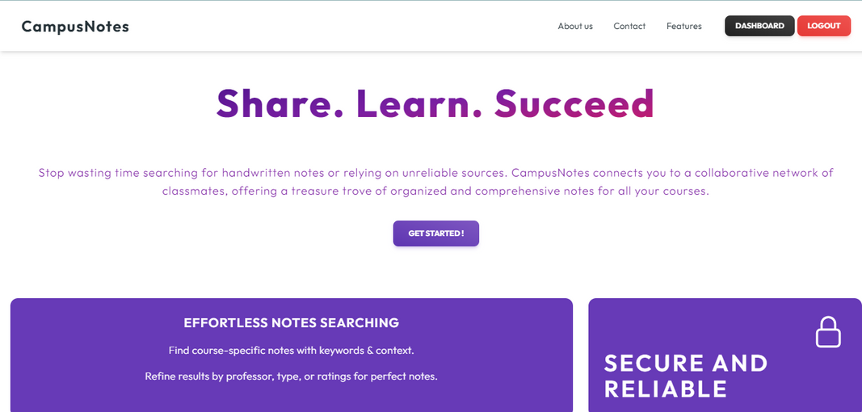
Introduction
In today's digital world, learning is becoming more interactive and accessible thanks to technology. CampusNotes is a new web platform designed specifically for engineering students. It's like a digital library where students can find all kinds of study materials, like notes and textbooks, for their courses. Using CampusNotes is easy; you just search for what you need, and you can even upload your own notes to share with others.

Slide 3

Objectives
Facilitate seamless access to educational resources.
Promote collaboration and peer-to-peer learning.
Enhance user experience through intuitive design.
Support academic success and student engagement.

Slide 4
Features
Resource
Repository
Search and Filter
Notes Upload
Chat Assistance

Slide 5
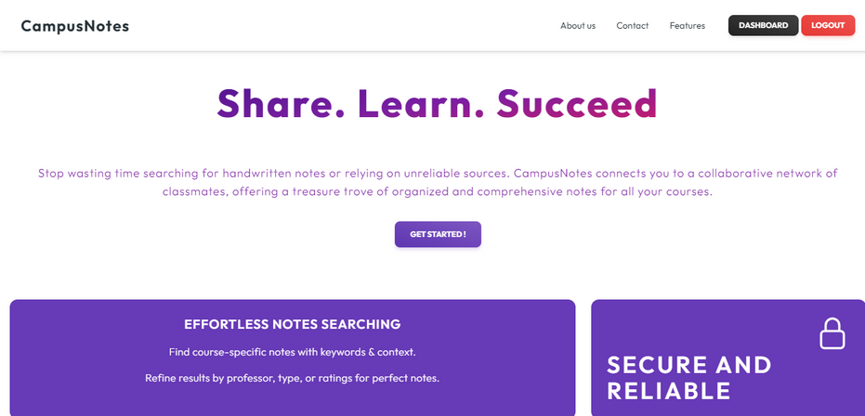
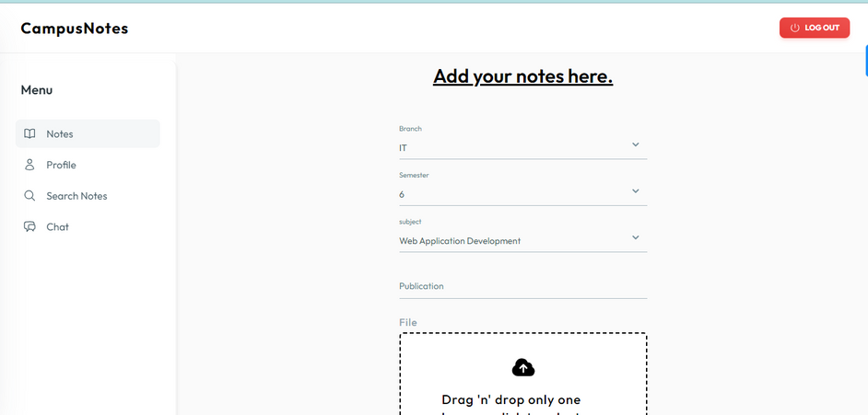
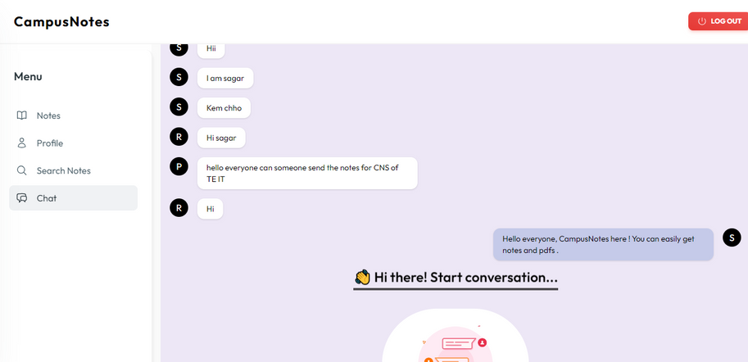
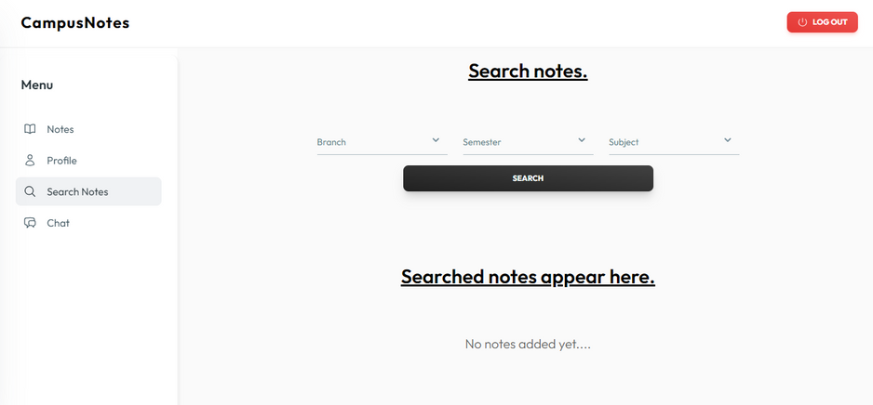
Design

Slide 6
Technologies Used
Backend :
Express.js
Node.js
Google API(drive)
MongoDB
Frontend :
React
.Talwind CSS and material Tailwind
JavaScript

Slide 7
Challenges
1. File storage problem
2. Deployment Challenge
3.Resource Availability
4.Technical Complexity

Slide 8
Future Scope
1. File sharing in Chat section
2. Integration with Learning Management Systems (LMS)
3.Advanced Search Capabilities
4. Community Building Features

Slide 9
References
1."The Effect of Educational Technology on Student Learning Outcomes: A Meta-Analysis" by Robert B. Kozma: https://www.researchgate.net/publication/222276467_The_Effect_of_Educational_Technology_on_Student_Learning_Outcomes_A_Meta-Analysis
2."Collaborative Learning: Cognitive and Computational Approaches" by Gerry Stahl: https://www.springer.com/gp/book/9789401060425
3.Tailwind CSS Official Documentation: https://tailwindcss.com/docs
4.Material Tailwind Official Documentation: https://material-tailwind.com/docs

Slide 10
Thank you

